Slide 1
Continuous Integration and Delivery (CI/CD) Pipeline
Surtej Sarin, Geoffrey Ellal, Jeff Oh and Naman Rawal
Booz Allen Hamilton
11/15/2019

Slide 2
DevOps Principles
Culture
Automation
Measuring
Sharing and time to market
Notes:
DevOps –According to Martin Fowler, continuous delivery is a software discipline where you build software in such a way that the software can be released to production any time.

Slide 3
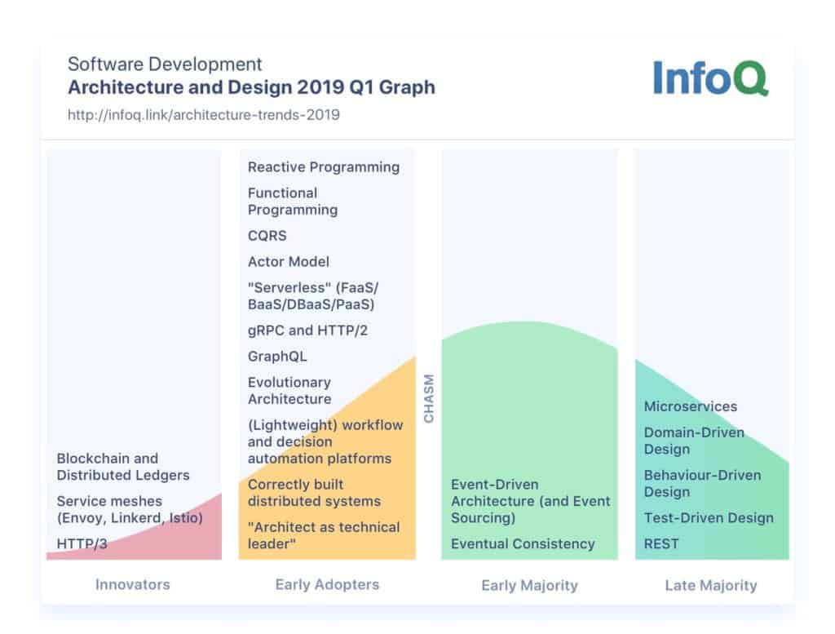
Notes:
February 2019 trends report by InfoQ on DevOps topics
4 ci/cd
Continuous Delivery
Highly repeatable
Reliable
Agile
Reducing costs and complexity
Reduce errors
“A CI/CD pipeline helps you automate steps in your software delivery process, such as initiating code builds, running automated tests, and deploying to a staging or production environment. Automated pipelines remove manual errors, provide standardized development feedback loops and enable fast product iterations.” - https://semaphoreci.com › blog › cicd-pipeline
Adhering to 12 factor apps

Slide 4
Case study
A Booz Allen engineering team needs to automate its software delivery process to allow for production readiness and increase speed of delivery for a defense client. In addition, they need to migrate and host the software and underlying infrastructure on the cloud, so that it is highly available.

Slide 5
Cloning from a GitHub Repository
https://github.com/aws-samples/aws-cicd-docker-containers

Slide 6
Services
AWS Services
AWS IAM
AWS ECS
AWS ECR
AWS CloudFormation
Jenkins
GitHub
Docker
Notes:
IAM - AWS Identity and Access Management (IAM) enables you to manage access to AWS services and resources securely. Using IAM, you can create and manage AWS users and groups, and use permissions to allow and deny their access to AWS resources.
ECS - Amazon Elastic Container Service (Amazon ECS) is a highly scalable, high-performance container orchestration service that supports Docker containers and allows you to easily run and scale containerized applications on AWS. Amazon ECS eliminates the need for you to install and operate your own container orchestration software, manage and scale a cluster of virtual machines, or schedule containers on those virtual machines.
ECR - Amazon Elastic Container Registry (ECR) is a fully-managed Docker container registry that makes it easy for developers to store, manage, and deploy Docker container images. Amazon ECR is integrated with Amazon Elastic Container Service (ECS), simplifying your development to production workflow. Amazon ECR eliminates the need to operate your own container repositories or worry about scaling the underlying infrastructure. Amazon ECR hosts your images in a highly available and scalable architecture, allowing you to reliably deploy containers for your applications.
CloudFormation - AWS CloudFormation provides a common language for you to describe and provision all the infrastructure resources in your cloud environment. CloudFormation allows you to use programming languages or a simple text file to model and provision, in an automated and secure manner, all the resources needed for your applications across all regions and accounts. This gives you a single source of truth for your AWS resources.

Slide 7
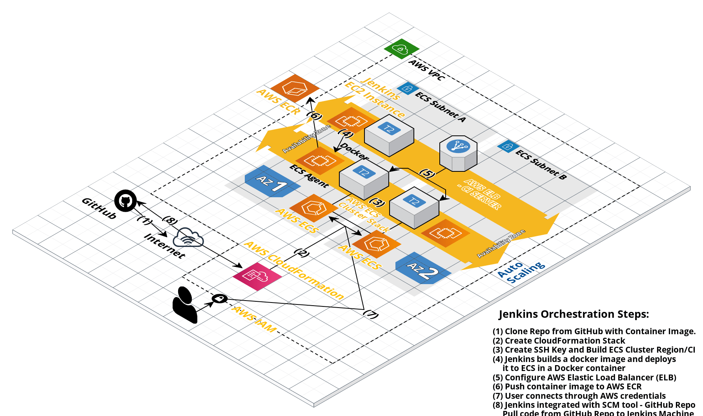
Architecture Diagram
Notes:
CI/CD Pipeline for Amazon ECS Using Jenkins, GitHub, and Amazon ECR
This project describes a continuous delivery pipeline that automatically builds and deploys your Docker images from a GitHub repository, pushes to an ECR registry and deploys them onto an ECS cluster.

Slide 8
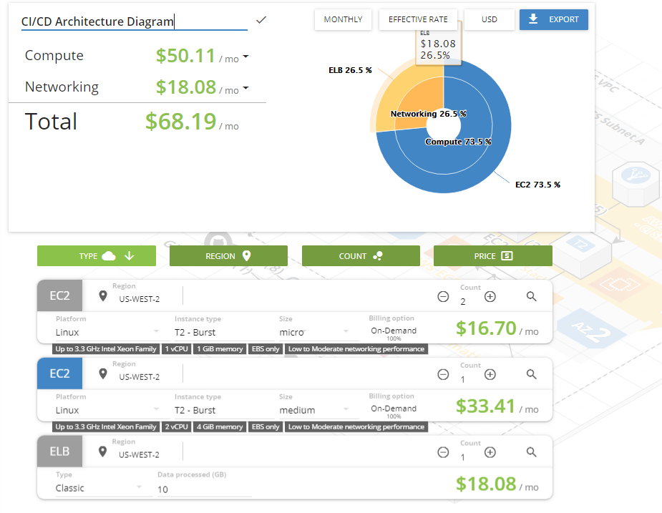

Slide 9
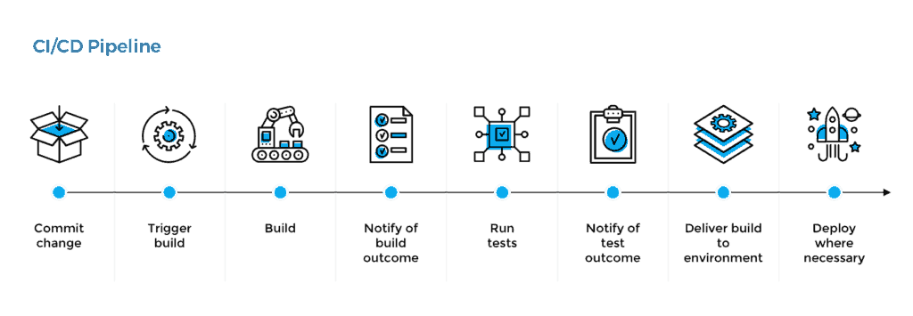
Solution results
Source code control
Continuous Integration
Testing
Deployment

Slide 10
Our GitHub Repository
https://github.com/ssarin/AWS_CloudWatch

Slide 11
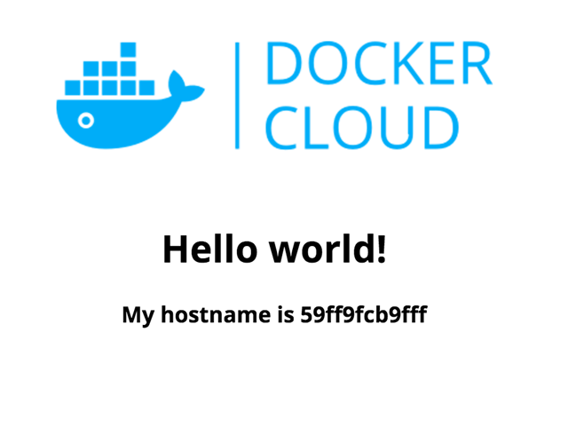
Notes:
Confirm that your service is running.
Log in to the AWS Management Console
Under compute, choose EC2 Container Service.
Choose the name of the cluster your created earlier, for example, getting-started.
On the services tab, choose the name of the service your created, for example, hello-world-service.
On the task tab, choose the RUNNING task.
Under Containers, click on the twisty next to the container name.
Under the network bindings, choose the IP address in the External Link column.

